Slide 1


Write LESS CSS and make it SASSier
Jake Adams
Thompson Coburn LLP

Slide 2







































Platinum Sponsors
Gold Sponsors
Silver Sponsors

Slide 3
About Me
Jake Adams
Senior Programmer Analyst
Thompson Coburn LLP
email: jacobladams@gmail.com
twitter: @jacobladams
geekswithblogs.com/jacobladams
github.com/jacobladams
Speakerrate.com/jacobladams

Slide 4
Overview
What?
Why?
SASS and LESS Setup
Features
Advanced
Links

Slide 5
What are SASS and LESS?
“CSS extension”
“CSS preprocessors”
“Higher-level CSS languages”
“CSS frameworks”

Slide 6

What are SASS and LESS?
SASS
CSS
$blue: #3bbfce;
$margin: 16px;
.content-navigation {
border-color: $blue;
color:
darken($blue, 9%);
}
.border {
padding: $margin / 2;
margin: $margin / 2;
border-color: $blue;
}
.content-navigation {
border-color: #3bbfce;
color: #2b9eab;
}
.border {
padding: 8px;
margin: 8px;
border-color: #3bbfce;
}

Slide 7
Why?
DRY Principle
D on’t
R epeat
Y ourself

Slide 8
Don’t Repeat Yourself
public Stats GetStatsDatabase()
{
Stats stats = new Stats();
using (SqlConnection conn = new SqlConnection("Data Source=mySvr;Initial Catalog=myDB;User ID=jake;Password=password"))
{
using (SqlCommand command = new SqlCommand("GetNumberOfAccounts", conn))
{
command.CommandType = CommandType.StoredProcedure;
conn.Open();
stats.NumberOfAccounts = (int)command.ExecuteScalar();
}
}
using (SqlConnection conn = new SqlConnection("Data Source=mySvr;Initial Catalog=myDB;User ID=jake;Password=password"))
{
using (SqlCommand command = new SqlCommand("GetNumberOfClients", conn))
{
command.CommandType = CommandType.StoredProcedure;
conn.Open();
stats.NumberOfClients = (int)command.ExecuteScalar();
}
}
using (SqlConnection conn = new SqlConnection("Data Source=mySvr;Initial Catalog=myDB;User ID=jake;Password=password"))
{
using (SqlCommand command = new SqlCommand("GetNumberOfEmployees", conn))
{
command.CommandType = CommandType.StoredProcedure;
conn.Open();
stats.NumberOfEmployees = (int)command.ExecuteScalar();
}
}
return stats;
}

Slide 9
Don’t Repeat Yourself
private string _connectionString = "Data Source=mySvr;Initial Catalog=myDB;User ID=jake;Password=password";
public Stats GetStatsDatabase()
{
Stats stats = new Stats();
stats.NumberOfAccounts = (int)GetDataFromStoredProcedure("GetNumberOfAccounts");
stats.NumberOfClients = (int)GetDataFromStoredProcedure("GetNumberOfClients");
stats.NumberOfEmployees = (int)GetDataFromStoredProcedure("GetNumberOfEmployees");
return stats;
}
private object GetDataFromStoredProcedure(string storedProcedure)
{
using (SqlConnection conn = new SqlConnection(_connectionString))
{
using (SqlCommand command = new SqlCommand(storedProcedure, conn))
{
command.CommandType = CommandType.StoredProcedure;
conn.Open();
return command.ExecuteScalar();
}
}
}

Slide 10
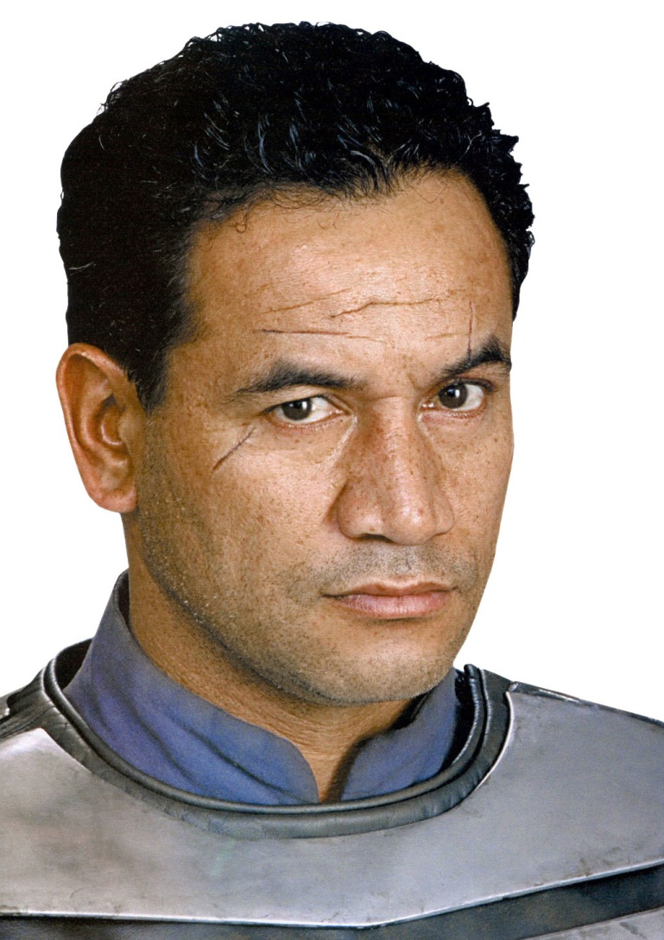
Don’t Repeat Yourself
Reduce Typing
Improve Maintainability
Reduce Errors
Improve readability
Jango Fett – repeated himself

Slide 11

Make the machines work for you, not vice versa…
Neo – made the machines work for him

Slide 12
HOW? – SETUP

Slide 13
How?
Install Tools
Usage
1) Command line - one time compile
2) Command line - watch file/folder
3) Dynamic compile/Plugin

Slide 14


Install SASS
SASS in written in Ruby
1) Install Ruby via Ruby Windows Installer
2) From command line
gem.bat install sass
s
1) Install IronRuby
2) From command line (as administrator)
igem.bat install sass

Slide 15
SASS Command Line Usage
One time compile
sass myStyleSheet.scss myStyleSheet.css
Watch file
sass --watch myStyleSheet.scss:myStyleSheet.css
Watch directory of Sass files
sass --watch app/sass:public/stylesheets

Slide 16
SassAndCoffee
.NET Library for ASP.NET and ASP.NET MVC which will automatically convert SASS and CoffeeScript files as they are requested.
Installation/Usage
1) Install SassAndCoffee NuGet package
2) Add link to compiled css file name
<link href="@Url.Content("~/Content/myStyleSheet.css")" rel="stylesheet" type="text/css" />
3) HTTP request for CSS file will be intercepted, the SASS file will be compiled and the output returned to the client

Slide 17

LESS
LESS is primarily written in JavaScript
1) Download less.js and include it along with .less file in HTML
2) JavaScript will run when page is accessed and .less will be compiled and applied at runtime.
<link rel="stylesheet/less" type="text/css" href="myStyleSheet.less">
<script src="less.js" type="text/javascript"></script>

Slide 18

LESS
1) Install node.js for windows
2) From command line
npm install less -g
Command line usage
lessc myStyleSheet.less myStyleSheet.css

Slide 19

LESS
1) Download dotless
Command line - one time compile
dotless.Compiler.exe myStyleSheet.less [myStyleSheet.css]
Command line - watch file
dotless.Compiler.exe --watch myStyleSheet.less [myStyleSheet.css]

Slide 20
LESS
NuGet Package
1) Install dotless NuGet package
2) Add link to .less file
<link href="@Url.Content("~/Content/myStyleSheet.less")" rel="stylesheet" />
3) HTTP request for .less file will be handled by the LESS compiler and a compiled CSS file will be returned to the client

Slide 21
Precompile vs. Dynamic Compilation
Precompile
Dynamic Compilation
Easier to deploy
Faster runtime performance
Quicker to get started
Easier Maintenance

Slide 22
Features

Slide 23
Variables
SASS
CSS
$pageWidth: 630px;
$headerHeight: 387px;
$mainGray: #999999;
$border: 0px dotted $mainGray;
$bgRepeat: no-repeat;
#container {
width: $pageWidth;
margin: auto;
background:url(rounded.jpg) $bgRepeat;
border: $border;
position: relative;
}
#pageHeader {
background: url(header.jpg) $bgRepeat;
border: $border;
width: $pageWidth;
height: $headerHeight;
}
#container {
width: 630px;
margin: auto;
background: url(rounded.jpg) no-repeat;
border: 0px dotted #999999;
position: relative; }
#pageHeader {
background: url(header.jpg) no-repeat;
border: 0px dotted #999999;
width: 630px;
height: 387px; }

Slide 24
Variables
SASS
LESS
$pageWidth: 630px;
$headerHeight: 387px;
$mainGray: #999999;
$border: 0px dotted $mainGray;
$bgRepeat: no-repeat;
#container {
width: $pageWidth;
margin: auto;
background:url(rounded.jpg) $bgRepeat;
border: $border;
position: relative;
}
#pageHeader {
background: url(header.jpg) $bgRepeat;
border: $border;
width: $pageWidth;
height: $headerHeight;
}
@pageWidth: 630px;
@headerHeight: 387px;
@mainGray: #999999;
@border: 0px dotted @mainGray;
@bgRepeat: no-repeat;
#container {
width: @pageWidth;
margin: auto;
background:url(rounded.jpg) @bgRepeat;
border: @border;
position: relative;
}
#pageHeader {
background: url(header.jpg) @bgRepeat;
border: @border;
width: @pageWidth;
height: @headerHeight;
}

Slide 25

Variable Scoping
SASS
LESS
$color: #000000;
.scoped {
$color: #ffffff;
color: $color;
}
.unscoped {
color: $color;
}
.scoped {
color: #ffffff; }
.unscoped {
color: #ffffff; }
@color: #000000;
.scoped {
@color: #ffffff;
color: @color;
}
.unscoped {
color: @color;
}
.scoped {
color: #ffffff;}
.unscoped {
color: #000000;}

Slide 26
Mixins
LESS
CSS
.annoyingFont{
font: bold 20px 'Comic Sans MS';
text-transform:uppercase;
text-decoration:underline
}
#footer{
.annoyingFont;
text-align:left;
padding:0 0 0 0;
margin:0 0 0 60px;
}
#pageHeader{
.annoyingFont;
width:630px;
height:387px;
}
.annoyingFont {
font: bold 20px 'Comic Sans MS';
text-transform: uppercase;
text-decoration: underline;
}
#footer {
font: bold 20px 'Comic Sans MS';
text-transform: uppercase;
text-decoration: underline;
text-align: left;
padding: 0 0 0 0;
margin: 0 0 0 60px;
}
#pageHeader {
font: bold 20px 'Comic Sans MS';
text-transform: uppercase;
text-decoration: underline;
width: 630px;
height: 387px;
}

Slide 27
Mixins
SASS
CSS
@mixin annoyingFont{
font: bold 20px 'Comic Sans MS';
text-transform:uppercase;
text-decoration:underline
}
#footer{
@include annoyingFont;
text-align:left;
padding:0 0 0 0;
margin:0 0 0 60px;
}
#pageHeader{
@include annoyingFont;
width:630px;
height:387px;
}
#footer {
font: bold 20px 'Comic Sans MS';
text-transform: uppercase;
text-decoration: underline;
text-align: left;
padding: 0 0 0 0;
margin: 0 0 0 60px;
}
#pageHeader {
font: bold 20px 'Comic Sans MS';
text-transform: uppercase;
text-decoration: underline;
width: 630px;
height: 387px;
}

Slide 28
CSS3 Vendor Prefixes
Prefix | Organization
-ms- | Microsoft
-webkit- | Apple, Google
-moz- | Mozilla
-o- -xv- | Opera
Example:
roundedCorners{
-moz-border-radius: 5px;
-webkit-border-radius: 5px;
border-radius: 5px;
}

Slide 29
Mixins – CSS3 and Vendor Prefixes
CSS
SASS
.page {
-moz-border-radius: 5px;
-webkit-border-radius: 5px;
border-radius: 5px;
background: #999999;
}
@mixin roundedCorners{
-moz-border-radius: 5px;
-webkit-border-radius: 5px;
border-radius: 5px;
}
.page {
@include roundedCorners;
background: #999999;
}

Slide 30
Parametric Mixins
SASS
CSS
@mixin roundedCorners($radius: 10px){
-moz-border-radius: $radius;
-webkit-border-radius: $radius;
border-radius: $radius;
}
.page {
@include roundedCorners(5px);
background: #999999;
}
.page {
-moz-border-radius: 5px;
-webkit-border-radius: 5px;
border-radius: 5px;
background: #999999;
}

Slide 31
Arguments Parameter

Slide 32
LESS – Mixins without Replication
LESS
CSS
.annoyingFont(){
font: bold 20px 'Comic Sans MS';
text-transform:uppercase;
text-decoration:underline
}
#footer{
.annoyingFont;
text-align:left;
padding:0 0 0 0;
margin:0 0 0 60px;
}
#pageHeader{
.annoyingFont;
width:630px;
height:387px;
}
#footer {
font: bold 20px 'Comic Sans MS';
text-transform: uppercase;
text-decoration: underline;
text-align: left;
padding: 0 0 0 0;
margin: 0 0 0 60px;
}
#pageHeader {
font: bold 20px 'Comic Sans MS';
text-transform: uppercase;
text-decoration: underline;
width: 630px;
height: 387px;
}

Slide 33
Selector Inheritance – SASS ONLY
SASS
CSS
.annoyingFont{
font: bold 20px 'Comic Sans MS';
text-transform:uppercase;
text-decoration:underline
}
#footer{
@extend .annoyingFont;
text-align:left;
padding:0 0 0 0;
margin:0 0 0 60px;
}
#pageHeader{
@extend .annoyingFont;
width:630px;
height:387px;
}
.annoyingFont, #footer, #pageHeader {
font: bold 20px 'Comic Sans MS';
text-transform: uppercase;
text-decoration: underline;
}
#footer {
text-align: left;
padding: 0 0 0 0;
margin: 0 0 0 60px;
}
#pageHeader {
width: 630px;
height: 387px;
}

Slide 34

BREAK TIME!

Slide 35
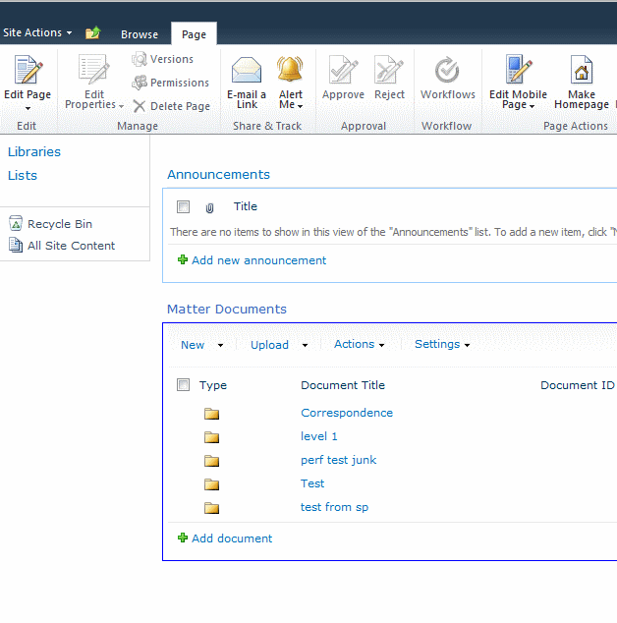
Guess the Mess
The core.css file is the main css file for SharePoint.
Reply to me on twitter (@jacobladams) your guess for how many total lines in core.css you have to change:
all the fonts from Verdana
primary text color from #6f9dd9

Slide 36
Imports - LESS
LESS
CSS
//a.less
@import "b.less";
@width: 960px;
.content{
width: @width;
}
//b.less
@width: 640px;
.page{
width: @width;
}
//a.less
.page {
width: 960px;
}
.content {
width: 960px;
}

Slide 37
Imports - LESS
LESS
CSS
//a.less
@import "b.css";
@width: 960px;
.content{
width: @width;
}
//b.less
@width: 640px;
.page{
width: @width;
}
//a.css
@import "b.css";
.content {
width: 960px;
}
//b.css
.page {
width: 640px;
}

Slide 38
Imports - SASS
LESS
CSS
//a.scss
@import "b.scss";
$width: 960px;
.content{
width: $width;
}
//b.scss
$width: 640px;
.page{
width: $width;
}
//a.css
.page {
width: 640px;
}
.content {
width : 960px;
}

Slide 39
Imports - SASS
LESS
CSS
//a.scss
@import "b.css";
$width: 960px;
.content{
width: $width;
}
//b.scss
$width: 640px;
.page{
width: $width;
}
//a.css
@import url(b.css);
.content {
width: 960px;
}
//b.css
.page {
width: 640px;
}

Slide 40
Nesting
CSS
SASS/LESS
#linkList {
position: absolute;
left:160px;
right:auto;
padding:0 0 0 0;
border:0px dotted #666666;
}
#linkList ul {
text-align: left;
list-style: none;
margin: 0 0 0 0;
padding:0 0 15px 35px;
border:0px dotted #666666;
width:120px;
}
#linkList ul li{
margin: 0;
padding: 3px 0 3px 0;
border-bottom: 1px dotted #999999;
}
#linkList ul li a{
border-bottom: none;
}
#linkList {
position: absolute;
left:160px;
right:auto;
padding:0 0 0 0;
border:0px dotted #666666;
ul {
text-align: left;
list-style: none;
margin: 0 0 0 0;
padding:0 0 15px 35px;
border:0px dotted #666666;
width:120px;
li{
margin: 0;
padding: 3px 0 3px 0;
border-bottom: 1px dotted #999999;
a{
border-bottom: none;
}
}
}
}

Slide 41

Operations
SASS
CSS
$containerWidth: 960px;
$pageWidth: $containerWidth *2/3;
#container{
width:$containerWidth;
}
#page{
width:$pageWidth;
}
#sidebar{
width:$containerWidth - $pageWidth;
}
#container {
width: 960px;
}
#page {
width: 640px;
}
#sidebar {
width: 320px;
}

Slide 42
Functions - Common
RGB Color Functions
rgb
rgba
red
green
blue
mix
Math Functions
percentage
round
ceil
floor
abs
HSL Color Functions
hsl
hsla
hue
saturation
lightness
alpha
lighten
darken
saturate
desaturate
grayscale/greyscale
complement
fadein/fade-in/opacify
faseout/fade-out/transparentize

Slide 43
Function - Unique
SASS
LESS
adjust-color
scale-color
change-color
unquote
quote
length
nth
join
append
type-of
unit
unitless
comparable
e
escape
_math
color
number
isPixel
isPercentage
IsString
isNumber
isColor
isEm
_isa
clamp

Slide 44
Comments
Supports standard CSS block comments
/*
Standard CSS block comments
work as expected
*/
Also supports “silent” single line comments
// Single line comments.
// These will be excluded from the generated CSS

Slide 45
String Interpolation

Slide 46

Bonus Material / Advanced features

Slide 47
SASS Indented Syntax
.SCSS
.SASS
ul {
text-align: left;
list-style: none;
margin: 0 0 0 0;
padding:0 0 15px 35px;
border:0px dotted #666666;
width:120px;
li{
margin: 0;
padding: 3px 0 3px 0;
a{
border-bottom: none;
}
}
}
ul
text-align: left;
list-style: none;
margin: 0 0 0 0;
padding:0 0 15px 35px;
border:0px dotted #666666;
width:120px;
li
margin: 0;
padding: 3px 0 3px 0;
a
border-bottom: none;

Slide 48
SASS Indenter Syntax
Uses indentation instead of { and } for blocks
Has .sass extension instead of .scss
Inspired by HAML

Slide 49
Frameworks
SASS
Compass – Provides SASS templates, image spriting, and more
LESS
Twitter Bootstrap – template style, grid system, widgets, and more
Both
Frameless – grid/layout framework

Slide 50
Minify and other command line options

Slide 51
Conditional and control structure – sass only

Slide 52
LESS Guard Statements and Pattern Matching

Slide 53
Sass Parent References

Slide 54
LESS JavaScript watch option

Slide 55
Links
Link Bundle:
bitly.com/bundles/jacobladams/3
Includes
The slides for this presentation
Sass
Less
Ruby Installer
SassAndCoffee
Dotless
Iron ruby
Node.js
Compass
Twitter bootstrapper
Comparison Articles

Slide 56
Questions?

Slide 57
If you think of a question/comment later?
Jake Adams
Senior Programmer Analyst
Thompson Coburn LLP
email: jacobladams@gmail.com
twitter: @jacobladams
geekswithblogs.com/jacobladams
github.com/jacobladams
Speakerrate.com/jacobladams
Link Bundle: bitly.com/bundles/jacobladams/3

